Slide 1



Portfolio Committee on Tourism
11 November 2025
Presented by Dr. Eddy Khosa, Chairperson

Slide 2
Presentation Outline
1. Our Governance Structure
2. Our Mandate: Why We Exist
3. Our Foundation: Principles that Guide Us
4. Progress to date
5. The Accreditation & Verification Landscape (SANAS)
6. Our Plan of Action
7. Conclusion
Tourism Transformation Council of South Africa (TTCSA) | “Driving Transformation in the Tourism Sector in line with the B-BBEE Act”

Slide 3
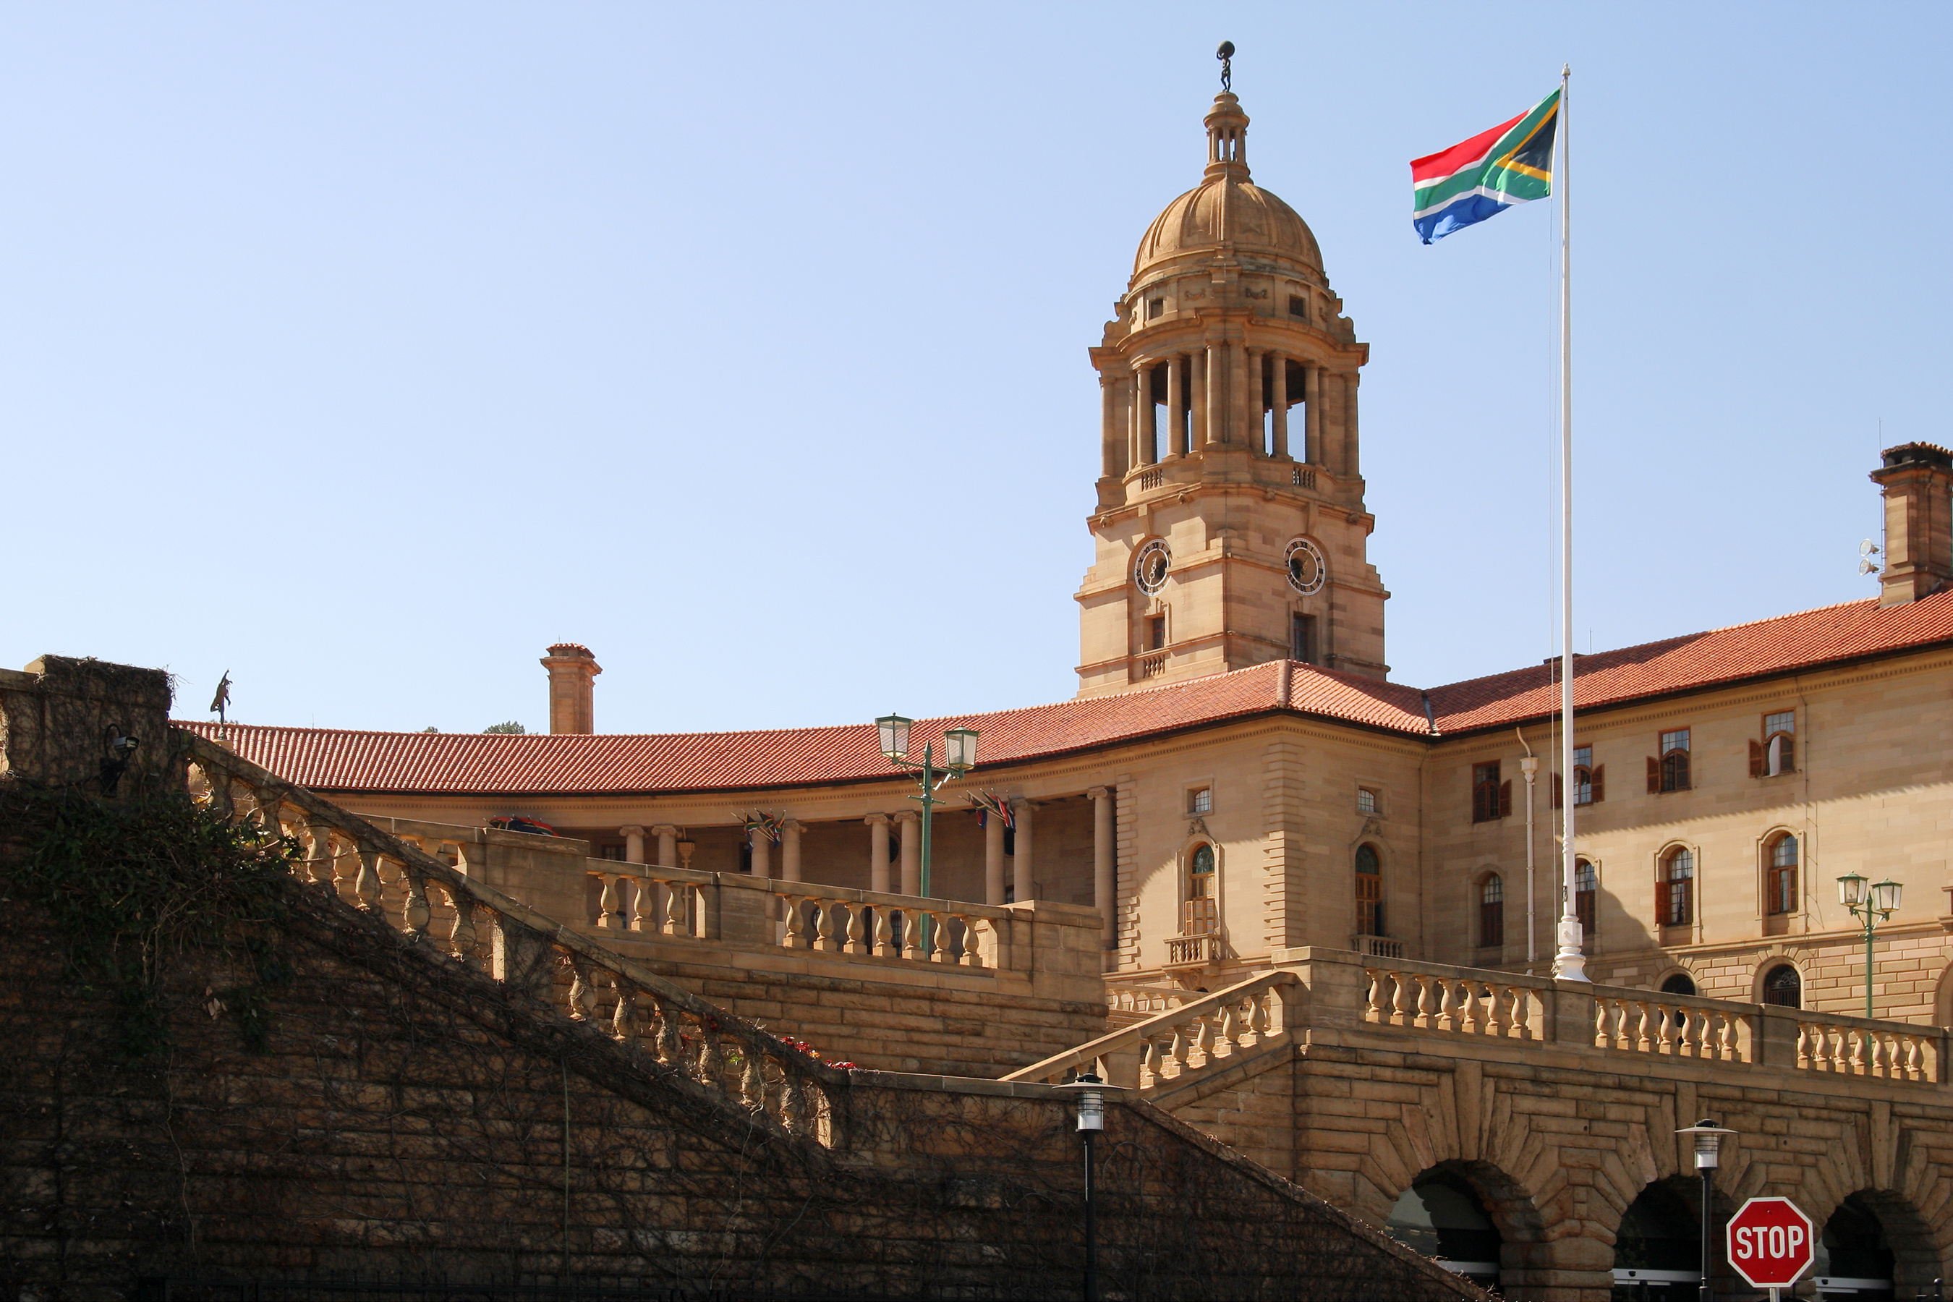
TTCSA GOVERNANCE STRUCTURE

Slide 4
Background Introduction
The Broad-Based Black Economic Empowerment (B-BBEE) Act in South Africa has its origins in the country's transition to democracy and the need to address the economic inequalities created by apartheid.
2003: Broad-Based Black Economic Empowerment Act (Act No. 53 of 2003) was signed into law by President Thabo Mbeki, aiming to promote broad-based black economic empowerment through various mechanisms, including ownership, management, skills development, employment equity, enterprise development, procurement and socio-economic development.
The Act provided for gazetting of Statement 003 which outlines functions of the Council, the joint funding obligation of Council by line Ministry and private sector and registration of Council as legal entity existing for non-profit making.
2005: Tourism Charter signed, and first Charter Council appointed, led by Mr. Tim Modise.
2007: The B-BBEE Codes of Good Practice were gazetted, providing a framework for the implementation of B-BBEE in South Africa. The Codes introduced the concept of the "B-BBEE scorecard" and the five elements of B-BBEE: ownership, management control, skills development, enterprise and supplier development, and socio-economic development.

Slide 5
Background Cont..
2015: The Amended Tourism B-BBEE Sector Code was gazetted for implementation in terms of Section 9 (1) of the B-BBEE Amendment Act No. 46 of 2013 – binding on all stakeholders operating in the Tourism Sector.
2016: Baseline study to determine the state of compliance with the Amended Tourism Sector Code was conducted, and the third Council appointed led by late Dr Vuyo Mahlati.
2018: Comparative analysis study - state of compliance with the 2009 Code and the amended Code gazetted in 2015 - was conducted.
2019: The Minister of Tourism appointed the fourth Council, led by Ms Lindiwe Sangweni-Siddo.
2019: The Reviewed Tourism B-BBEE Sector Code was submitted to the DTIC for gazetting.
2024: The fifth Tourism B-BBEE Sector Council was appointed, led by Dr Eddy Khosa.

Slide 6
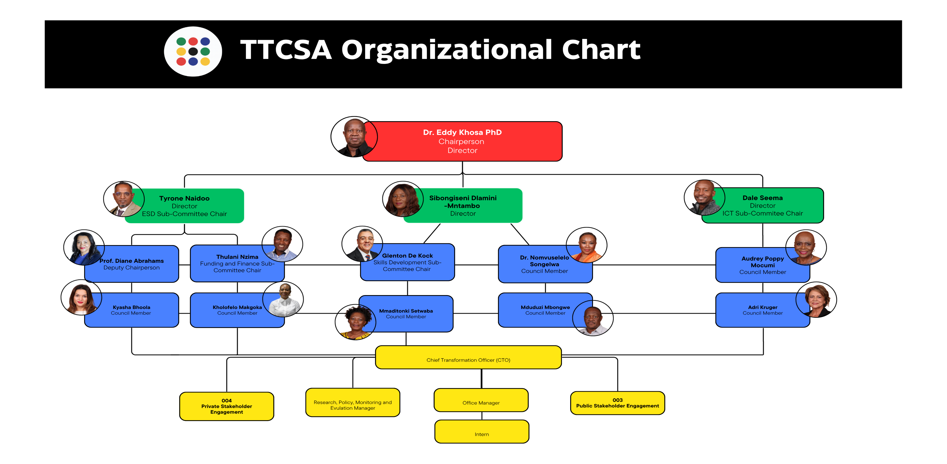

Slide 7
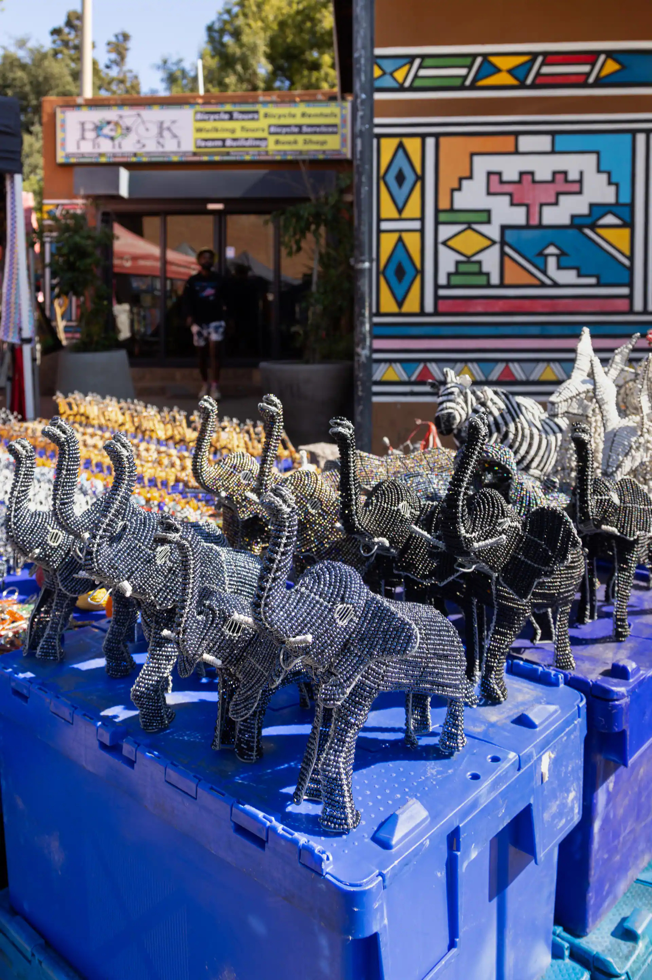
TTCSA MANDATE

Slide 8
TTCSA Mandate
1
2
3
Provide guidance on sector-specific matters effecting B-BBEE
Compile reports on the status of B-BBEE within the sector
Share information with sector members
Notes:
The strategy proposes 6 outcome-oriented goals:

Slide 9

Reporting
Minister of Tourism (Line Minister)
B-BBEE Commission
B-BBEE Presidential Advisory Council
Minister of Trade and Industry pertaining to B-BBEE in the sector
Approved accreditation agencies
Notes:
e.g. the Beneficiation Action Plan of the department of trade & industry, the governing party’s State Intervention in the Minerals Sector report, the Industrial Action Policy Plan, New Growth Path and of late the National Development Plan etc.

Slide 10
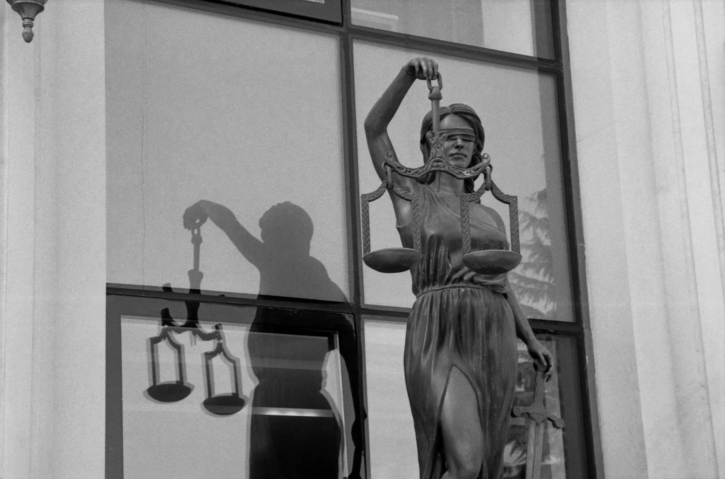
Foundation/
Compliance

Slide 11



Our Foundation
Institutional Establishment
Compliance and Legal Framework
Joint Funding Agreement (2021)
    Registered as a Non-Profit Company (NPC) – Registration No: 2020/216206/08
    Fourteen Council members appointed.
    Four of the Council Members serve as Directors.
    Four of the Council Members serve as Sub-committee Chairs: ICT, Finance and funding, ESG and Skills Development.
    Term of Office three years- Council Constitution.
    Tax Clearance Certificate issued by SARS
    Skills Development Levy (SDL) registered
    Unemployment Insurance Fund (UIF) compliant
    PAYE system implemented for employees.
    VAT registration still Work in progress.
    Guided by King IV Corporate Governance Principles/ Companies Act/ Section 38 J, PFMA
    Joint Funding Agreement signed between Private Sector and Government
    Letter of Assurance issued to the Private Sector confirming accountability, transparency and Independence.
Tourism Transformation Council of South Africa (TTCSA) | “Driving Transformation in the Tourism Sector in line with the B-BBEE Act”

Slide 12

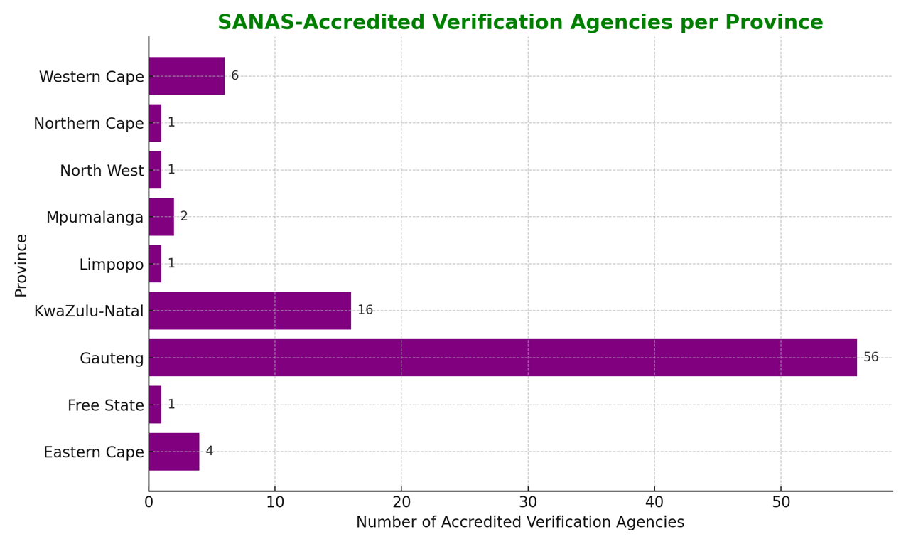
SANAS Accreditation Overview
  SANAS accredits Verification Agencies responsible for B-BBEE verifications in Tourism valid for a period of four years (4).
  Agencies issue B-BBEE certificates to qualifying Businesses which is valid for a period of One year (12 Months). Agencies ensure compliance with the Tourism Sector Code(S)
Tourism Transformation Council of South Africa (TTCSA) | “Driving Transformation in the Tourism Sector in line with the B-BBEE Act”

Slide 13

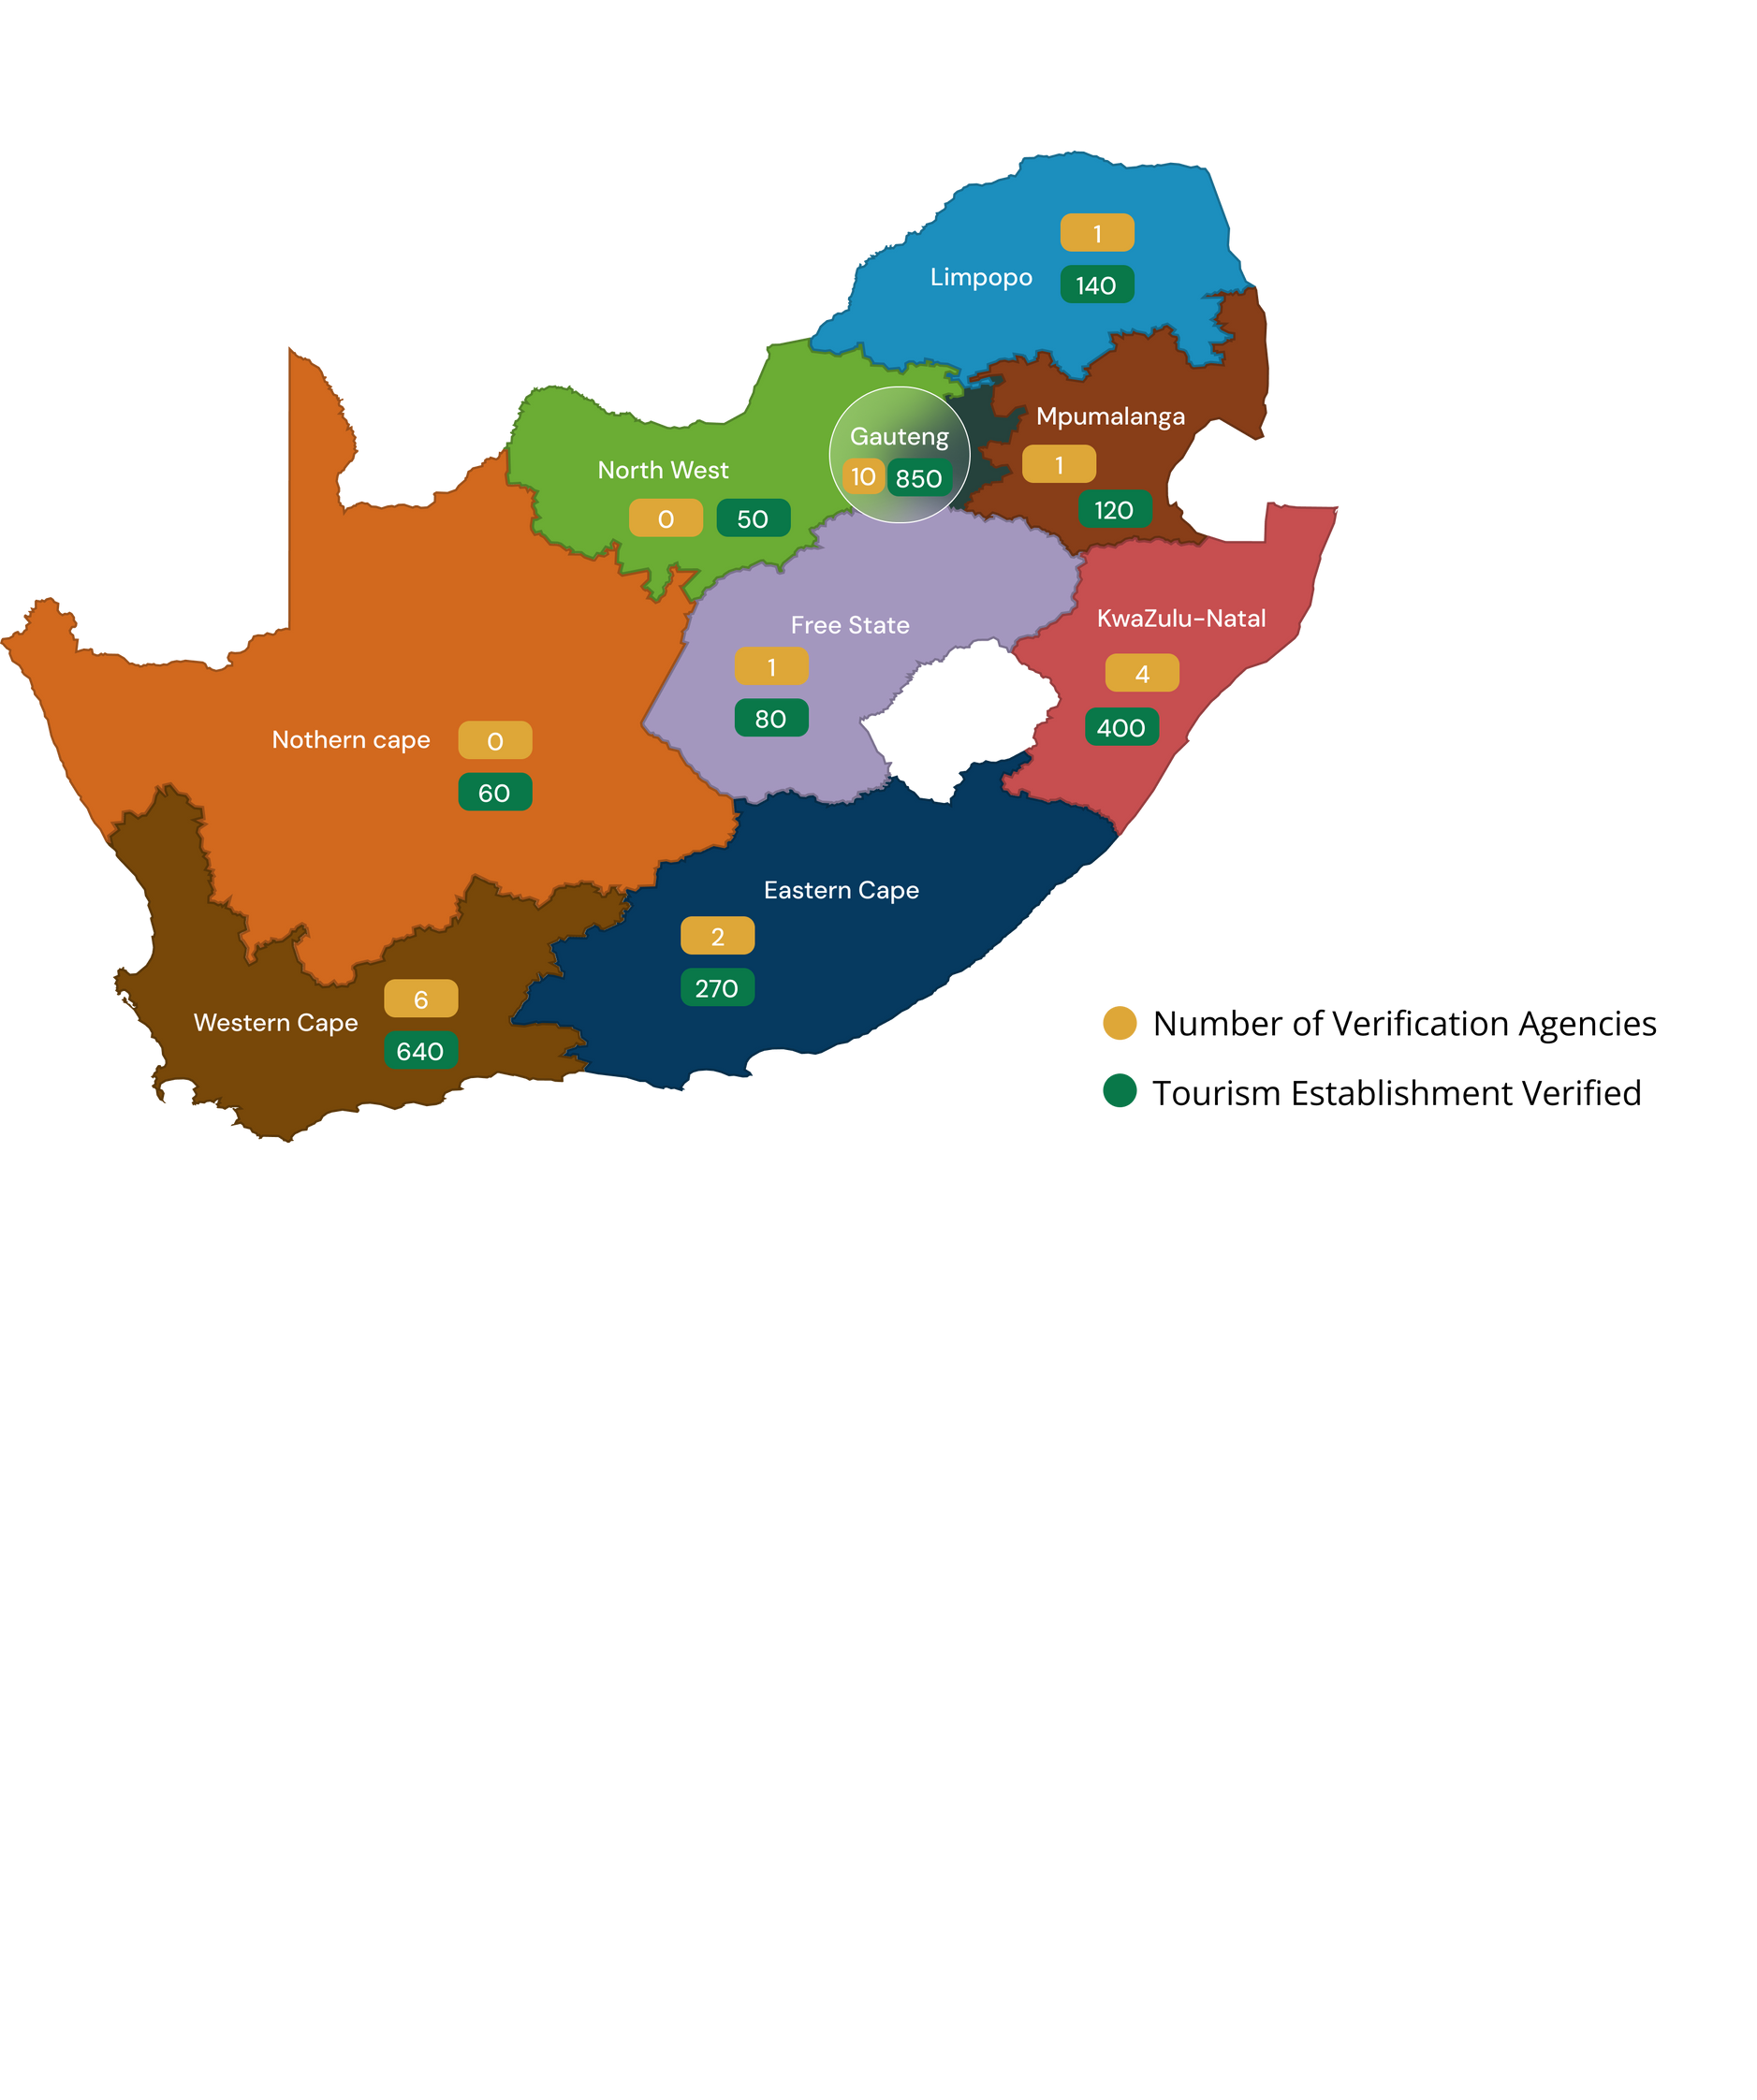

Provincial Verification & Tourism Distribution
Data Source
  SANAS (2025) : List of accredited B-BEEE Verification Agencies for the Tourism Sector
  Tourism Grading Council of South Africa (TGCSA, 2025): Provincial statistics of graded tourism establishments
Tourism Transformation Council of South Africa (TTCSA) | “Driving Transformation in the Tourism Sector in line with the B-BBEE Act”

Slide 14

Plan of Action

Slide 15
Plan of Action Statement 003
FOCUS AREA | RATIONALE | TARGET GROUP | PROPOSED ACTIONS | PERIOD | TARGET | Budget ‘000
Ensure effective monitoring of compliance with the B-BBEE Codes | Guidance and Advisory - Government in collaboration with the industry to improve the reporting of individual firms and collection and collating of data related to the compliance with the codes in a manner that draws upon the statutory reporting of Employment Equity and BEE Verification without putting more reporting burden nor risking exposing commercially sensitive information of the reporting firms. | Government Private Sector | Introduction of a reporting tool to ensure transparency and accountability. Conduct regular studies to monitor the state of transformation. Determine the uses of various State Levers (e.g. Business of government; Procurement Tools; Concessions; Licencing (Gaming and Gambling) and Leases for State Owned Properties) to transform the industry across the tourism value chain (Specialized Enterprises) Alignment to the applicable legislation for guidance – Statement 003 of the Codes of Good Practice and Statement 9 of the B-BBEE Act | 2025 Ongoing | Annual report on the state of transformation developed. First steps of Facilitating sector code implementation First steps of Stakeholder engagement | R1 500
15

Slide 16
Plan of Action Statement 003 Cont…
Reviewing and Gazetting of sector codes | Per the Paragraph 6 of Statement 003, the main responsibility of a Charter Council is to develop the sector codes and to monitor their implementation thereof. | Government Private Sector | Receive a letter from the Minister of DTIC with comments on application made Develop a Draft Tourism B-BBEE Sector Codes Develop stakeholder consultation schedule Consolidation of comments into the Draft Code Application to the DTIC for gazette of the Amended Tourism B-BBEE Sector Codes | 2025 Ongoing | Application for Amendment of Tourism B-BBEE Sector Codes submitted to the DTIC. With the above, research, reporting, compliance and remedial actions to take affect within suggestions created by the TTCSA to amend the Tourism Sector Codes | R1 155
16

Slide 17
Plan of Action Statement 003 Cont…
Stakeholder engagement | Research,reporting and information Sharing - Paragraph 6.4 outlines the functions of the Sector Charter Council which may include sharing of information on B-BBEE to create awareness | Government Private Sector | Develop Stakeholder engagement plan Develop a report and advisory note | 2025 Ongoing | Awareness on B-BBEE Sector Code Conducted. Advisory notes drafted B-BBEE workshops held. | R1 500
17

Slide 18
Plan of Action Statement 003 Cont…
Database | Compliance, Remedial Actions and Possible Empowerment Programmes Recommended | Government Private Sector (big and small) | Assess the state of compliance and recommend remedial action | 2025 Ongoing | Identify strength and weaknesses within the sector | R1 700
18

Slide 19
PROGRESS TO DATE

Slide 20

Progress to date
04 Sept 24: Minister inaugurated the Council and requested that they develop a plan to drive transformation aligned to the three strategic priorities of the GNU, which are:
- Drive inclusive growth and job creation
- Reduce poverty and tackle the high cost of living
- Build a capable, ethical and developmental state.
- Do a survey to assess transformation in the sector.
16-17 Oct 24: the Council held two days meeting (17 & 18) to receive Handover Report from the previous Council. The report was well received, and further resolved to implement the Joint Funding Agreement signed in Aug 21 and to re-institute TTCSA as an independent organisation as recommended by the Portfolio Committee.
31 Oct 24: Council opened its bank account at the First National Bank.
Notes:
To achieve this vision, it will be the mission of the provincial government of KwaZulu-Natal, in collaboration with its social partners, to ensure that mineral beneficiation is well-integrated within the provincial economy and provincial developmental goals, specifically to ensure:

Slide 21
Progress Cont..
The Council also received reports from the Department of Tourism on transformation programs and the DTIC on the Codes amendments.
29 Oct 24: TTCSA was registered with the CIPC as an NPC.
March 25: Minister was presented with the following documentation for institutionalisation of TTCSA:
        Business Case
        Financial Budget
        Joint Funding Agreement
        Constitution Reviewal
        Terms of References for new study on transformation
        Plan of Action
Department is in liaison with the National Treasury to effect creation of transfer budget line item to help fund TTCSA operations (currently the Council is able to access support services required through the Department of Tourism)
Notes:
To achieve this vision, it will be the mission of the provincial government of KwaZulu-Natal, in collaboration with its social partners, to ensure that mineral beneficiation is well-integrated within the provincial economy and provincial developmental goals, specifically to ensure:

Slide 22
Progress Cont..
Signed Joint Funding Agreement (JFA)
- TBCSA effected the JFA signed by the previous Council in 2021 to help take the work of the TTCSA forward
Transfer of funds
  In April 2025, TBCSA transferred R5.2m into the coffers of the TTCSA
Procurement of Office Space
  TTCSA procured Council offices in Auklandpark, Jhb
Appointment of Council staff
  - Stakeholder Manager appointed in June 2025
  - Office Assistant post filled in June 2025
  - Intern post was filled in June 2025
  - Research, Policy, Monitoring & Evaluation Manager appointed in July 2025
  - Chief Transformation Officer (CTO) appointed in August 2025
  - Total of 1 male & 4 females

Slide 23
Progress Cont..
Memorandum of Agreement (MOA)
  - Currently being developed and it will inform details of engagement including financial information.
Remuneration of the Council
  - Meeting on the Remuneration of Council was held with National Treasury on 04 Nov 2025 for determination and they will issue recommendation for Ministers’ determination.
Council own website
- Website, with emails and Council own branding, banners & flags etc were developed.
TTCSA B-BBEE Compliance
- The organisation has been verified for B-BBEE compliance and the last verification yielded a Level 4 B-BBEE Status
Compliance to tax and Skills Development
- TTCSA is complaint to SARS tax laws and Labour’s Skills Development Levy
Annual Survey
- Tender to appoint a service provider to conduct a new study on transformation has been advertise on 31 Oct 2025

Slide 24



Conclusion
TTCSA has successfully established a robust governance framework and operational foundation within its inaugural year.
Strategic partnerships and collaborations are key to strengthening transformation across the tourism sector.
TTCSA remains steadfast in its commitment to inclusivity, accountability, and sustainable transformation.

Slide 25
THANK YOU
www.tourismtransformation.co.za
076 582 6078
087 3534889
admin@tourismtransformation.co.za
24 Owl Street, Metal Box Building, 13th Floor, Braamfontein Werf, Johannesburg, 2092
Tourism Transformation Council of South Africa (TTCSA) | “Driving Transformation in the Tourism Sector in line with the B-BBEE Act”

